Slide 1
CYB 110 CYBERSECURITY AND PRIVACY MODULE 10 – NETWORK SECURITY JIM ALVES-FOSS AND JIA SONG

Slide 2
NETWORKING BACKGROUND
What are networked systems?
A set of devices (hosts) connected by a communication medium that are able to share data through transmission over the media
System Characteristics include (but are not limited to)
Physical properties of the communication signals
Physical topology of the communication medium and logical topology of the data transmission
Format and timing of the signals
Error and Flow control, connection management, recovery, security

Slide 3
NETWORKING BACKGROUND (2)
Why do we use networked systems?
To facilitate the sharing of resources
Printers
Disk/Tape drives
Computational Power
Data Sets
To permit the distribution of workload
Concurrent/parallel computing
Client-server computing
Fault tolerance
To facilitate the transfer of information
Database transactions
Electronic mail
Networked distribution of data -- archives

Slide 4
NETWORKING BACKGROUND (3)
How do data networks work?
Systems communicate over a shared communication medium according to an agreed upon convention (standard).
Several sets of standards currently exist:
DoD: TCP/IP
ISO: OSI model
Commercial: SNA, IPX, X.25, ...
Proprietary
In this course we will basically follow the seven layer approach defined by ISO with additional emphasis on the DoD hierarchy.

Slide 5
NETWORKING BACKGROUND (4)
DOD Model
hierarchical arrangement of entities that may communicate with peer entities in another system
one entity within a system provides services to other entities, and also uses the services of other entities
places importance on internetworking, i.e., when two communicating entities are not attached to the same network
places equal importance on connectionless and connection oriented systems
consists of 802.X, X.25, TCP/UDP/IP and FTP, TELNET, SMTP, NSP and SNMP protocols

Slide 6
NETWORKING BACKGROUND (5)
ISO/OSI Model
communication functions are partitioned into a vertical set of seven layers
each layer performs a related subset of functions required for communication
each layer provides services to the next highest layer while depending on the next lower layer to perform more primitive functions
decomposes one problem into a number of more manageable subproblems
communication is achieved by having corresponding (peer) entities in the same layer in two different systems communicate via a protocol

Slide 7
NETWORKING BACKGROUND (6)
each protocol entity sends data down to the next lower layer in order to get the data across to its peer entity
each entity communicates with entities in the layers above it and below it, across an interface
analogous to structures programming
protocols include: 8802.X, 8072/3, 8236/7, 8822/3/4/5, ...

Slide 8
ISO MODEL
ISO/OSI Reference Model
Provides a common basis for coordination of standards.
Based on a hierarchical model
Application Layer
Presentation Layer
Session Layer
Transport Layer
Network Layer
Data Link Layer
Physical Layer
I

Slide 9
ISO MODEL
Application
Application
Application
Presentation
Presentation
Presentation
Session
Session
Transport
Transport
Network
Network
Network
Network
Network
Network
Network
Data Link
Data Link
Data Link
Data Link
Data Link
Data Link
Data Link
Physical
Physical
Physical
Physical
Physical
Physical
Physical

Slide 10
ISO MODEL (2)
Layers of the ISO/OSI Hierarchy
Physical Layer
This layer is responsible for defining the method of transmitting bits of information across a transmission medium. This layer includes mechanical electrical, functional and procedural specifications. Examples of such standards are EIA-232-D (RS-232), Ethernet, Modem Standards.
Data Link Layer
This layer is responsible for managing transmission of information across a single communication link. It attempts to add reliability, flow and error control, and communication management (HDLC, LAP-B)

Slide 11
ISO MODEL (3)
Network Layer
This layer is responsible for providing communication between two hosts across a communication network. It provides the interface such that higher layers need not know about the underlying topology. It provides connection management, routing, and error and flow control. (X.25 is best known protocol, DoD’s IP fits in here too).
Transport Layer
Provides reliable end-to-end communication between processes on hosts. Ensures error-free delivery and sequencing and provides connection management. (DoD’s TCP best known).

Slide 12
ISO MODEL (4)
Session Layer
Provides ability to control flow of information (the dialogue) between end users, grouping of data and checkpointing for error-recovery.
Presentation Layer
This layer manages the syntax of the data being transmitted. It is responsible for conversion between different formats and representations. (e.g., virtual terminals, cryptography)
Application Layer
This layer provides management functions to support distributed applications utilizing the OSI environment.

Slide 13
DOD MODEL
DOD (TCP/IP) Network Stack
Developed in the 1970s
Part of project that grew into the modern internet
DoD Layers | ISO Layers | Protocols
Process Layer | Application Layer | SMTP, HTTP, FTP, etc.
Host-to-host Layer | Transport Layer | TCP, UDP
Internet Layer | Network Layer | IP. ICMP, IGMP
Network Access Layer | Logical Link Layer | Device Drivers (IEEE802.x)
 | Physical Layer | Network Adapters

Slide 14
ENCAPSULATION
For any layered network model, encapsulation is key. For example, for an http request:
HTTP
http request/response may include a large amount of data
TCP Header
HTTP
TCP provides connection management and reliable delivery
IP Header
TCP Header
HTTP
IP provides machine to machine delivery, may segment data
PPP
Point-to-Point Protocol provide delivery from one machine to next. may compress, modify, encrypt data, etc.
IP Header
TCP Header
HTTP

Slide 15
INTERNETWORKING (1)
Major issues behind internetworking
Network Service:
Networks attached to an internetwork may consist of connectionless LANs and connection oriented WANs.
Each network may have different delay rates, error control mechanisms, etc.
Protocol must integrate these services into a standard user interface

Slide 16
INTERNETWORKING (2)
Addressing
The NPA (network point of attachment) is a unique network wide identifier to address a particular user.
Naming structure may be different per network
Need an Open System Internetworking Environment (OSIE) with internetwork-wide addressing and name resolution (based on unique NSAPs = network service attachment point)

Slide 17
INTERNETWORKING (3)
Routing
ES = end-system (host); NPS = (Network address); IS = (Intermediate system/Gateway)
How does ES determine NPA address(es) of IS(s) attached to its network?
How does an IS determine NPA address of ESs attached to its network?
How does an ES select a specific IS when sending an NPDU?
How does an IS determine the NPA addresses of other ISs that are attached to the same network?
How does an IS select a specific IS to route an NPDU to a given destination ES?

Slide 18
INTERNETWORKING (4)
Quality of Service
Each network allows user to specify a set of expected performance parameters (transit delay; security; cost limits; expected residual error rate; priority)
These QOS parameters may be different for different networks
Must provide a means of letting each network entity build of knowledge of internetwork-wide QOS to be expected when going to any destination NSAP
How does this work over networks with different size constraints?

Slide 19
INTERNETWORKING (5)
Maximum Packet Size
Affected by error rates, transit delay, buffer limits, processing overhead (128-65,535 bytes are typical – depends upon protocol)
Each network has a maximum specified for transport layer to divide TPDU into segments or fragments.
Flow and Congestion Control
Completely different mechanisms are used for connection-oriented and connectionless networks
Must integrate these mechanisms to provide for internetwork-wide error and flow control
Error Reporting
Varies from one network type to another
A global scheme must be established to integrate these

Slide 20
INTERNETWORKING (6)
The Internet Protocol (IP)
RFC 791 https://tools.ietf.org/html/rfc791
Read the RFC, it is the official standard. Can you follow it?
1.1. Motivation
The Internet Protocol is designed for use in interconnected systems of packet-switched computer communication networks. Such a system has been called a "catenet" [1]. The Internet protocol provides for transmitting blocks of data called datagrams from sources to destinations, where sources and destinations are hosts identified by fixed length addresses. The Internet protocol also provides for fragmentation and reassembly of long datagrams, if necessary, for transmission through "small packet" networks.

Slide 21
INTERNETWORKING (7)
1.2. Scope
The Internet protocol is specifically limited in scope to provide the functions necessary to deliver a package of bits (an Internet datagram) from a source to a destination over an interconnected system of networks. There are no mechanisms to augment end-to-end data reliability, flow control, sequencing, or other services commonly found in host-to-host protocols. The Internet protocol can capitalize on the services of its supporting networks to provide various types and qualities of service.
1.3. Interfaces
This protocol is called on by host-to-host protocols in an Internet environment. This protocol calls on local network protocols to carry the Internet datagram to the next gateway or destination host.

Slide 22
INTERNETWORKING (8)
Where does IP fit?
Telnet
HTTP
FTP
TCP
UDP
Internet Protocol (IP) & ICMP
Local Network Protocol

Slide 23
INTERNETWORKING (9)
Network Addresses are 32 bits in IPV4
Class A (for large independent networks) they are indexed with a 7 bit netid and a 24 bit hostid (bit 1 = 0)
Class B (for corporate-wide networks) they are indexed with a 14 bit netid and a 16 bit hostid (bits 1,2 = 1,0).
Class C (for single small LANs) they are indexed with a 21 bits netid and an 8 bit hostid (bits 1-3 = 1,1,0). Note: many agencies locally divide their Class B into subnets similar to Class C (based on a subnet mask, where 1’s are used to indicate valid netid portion)
Class D multicast (bits 1-4 = 1,1,1,0) remaining 28 are group id.
all 1’s usually all-station broadcast, although address with bits 1-4 = 1,1,1,1 is technically reserved

Slide 24
INTERNETWORKING (10)
Network Addresses Continued:
Usually represented with dotted-decimal notation: 10.0.0.0 = (originally Arpanet – which no longer exists, now private); 129.101.100.1 = machine 1 on subnet 100 or machine 100.1 of Class B network 129.101
A local network may combine different LAN types (at the network layer), thus causing routers to be used and each network to have a unique net_id. The subnetworking of Class B networks is used to help reduce workload on ISs (routers/bridges) that combine the site-wide network into a single LAN. If not decoupled, each would be involved in overall internet routing.
Single gateway from site provides internetwork-wide routing, internally the subnetwork routing is handled.

Slide 25
INTERNETWORKING (11)
The IP NPDU: (see the RFC)
0 1 2 3
0 1 2 3 4 5 6 7 8 9 0 1 2 3 4 5 6 7 8 9 0 1 2 3 4 5 6 7 8 9 0 1
+-+-+-+-+-+-+-+-+-+-+-+-+-+-+-+-+-+-+-+-+-+-+-+-+-+-+-+-+-+-+-+-+
|Version| IHL |Type of Service| Total Length |
+-+-+-+-+-+-+-+-+-+-+-+-+-+-+-+-+-+-+-+-+-+-+-+-+-+-+-+-+-+-+-+-+
| Identification |Flags| Fragment Offset |
+-+-+-+-+-+-+-+-+-+-+-+-+-+-+-+-+-+-+-+-+-+-+-+-+-+-+-+-+-+-+-+-+
| Time to Live | Protocol | Header Checksum |
+-+-+-+-+-+-+-+-+-+-+-+-+-+-+-+-+-+-+-+-+-+-+-+-+-+-+-+-+-+-+-+-+
| Source Address |
+-+-+-+-+-+-+-+-+-+-+-+-+-+-+-+-+-+-+-+-+-+-+-+-+-+-+-+-+-+-+-+-+
| Destination Address |
+-+-+-+-+-+-+-+-+-+-+-+-+-+-+-+-+-+-+-+-+-+-+-+-+-+-+-+-+-+-+-+-+
| Options | Padding |
+-+-+-+-+-+-+-+-+-+-+-+-+-+-+-+-+-+-+-+-+-+-+-+-+-+-+-+-+-+-+-+-+
Example Internet Datagram Header

Slide 26
EX: TCPDUMP (-NX –R XXX.PCAP)
22:01:59.517328 IP 127.76.210.185.2507 > 127.0.0.1.10391: Flags [.], ack 507, win 350,
options [nop,nop,TS val 4294941147 ecr 4294941147], length 0
0x0000: 4500 0034 3b42 4000 4006 2e7b 7f4c d2b9
0x0010: 7f00 0001 09cb 2897 2ae5 a46c ce57 538b
0x0020: 8010 015e d12d 0000 0101 080a ffff 99db
0x000: ffff 99db
Version
IHL
Total Length
Identification
Fragment Offset
Checksum
QOS
DST IP
Flags
Time to Live
Protocol
SRC IP

Slide 27
THE TRANSPORT LAYER (1)
Quality of Service
A transport layer may provide ability for user to select/specify
Acceptable error and loss levels
Desired average and maximum delay
Desired average and minimum throughput
Priority Levels
Of course transport layer limited to inherent capabilities of underlying network service provided - therefore the transport layer will have varying degrees of success in providing the requested service
One method of providing this service is to provide different transport protocols for different classes of traffic:
1) A reliable connection-oriented protocol 2) A less reliable connection-oriented protocol 3) A speech protocol, requiring sequenced, timely delivery 4) A real-time protocol requiring high reliability and timeliness

Slide 28
THE TRANSPORT LAYER
Data Transfer
The whole purpose of the transport layer is of course to provide transport of data between two transport entities
User and control data can be on same or separate channels
Full-duplex must be supported although half-duplex and simplex may also be offered for special situations
User Interface
This may be application/environment
Could be:
Procedure calls
Passing of data and parameters to a process through a mailbox
Use of DMA
Common interface would be for flow control with transport users; timing; confirmation significance (local or remote)

Slide 29
THE TRANSPORT LAYER
Connection Management
Needs to be responsible for connection establishment and termination (for connection oriented services)
A symmetric and an asymmetric service should be provided
Termination can be abrupt or graceful
Expedited Delivery
This permits data to supersede the transport of data in the local agents queue
Status Reporting
Performance characteristics (throughput, mean delay); addresses (network, transport); class of protocol in use; current timer values; state of protocol “machine” supporting a connection; degradation in requested quality of service
Security - Of course, another fine service

Slide 30
TRANSPORT LAYER (1)
User Datagram Protocol (UDP)
RFC 768 https://tools.ietf.org/html/rfc768
Recall that the IP protocol provides a connectionless datagram service to users with no implicit error or flow control mechanism
To permit users to use this level of service, the User Datagram Protocol (UDP) was established
This User Datagram Protocol (UDP) is defined to make available a datagram mode of packet-switched computer communication in the environment of an interconnected set of computer networks. This protocol assumes that the Internet Protocol (IP) is used as the underlying protocol.
This protocol provides a procedure for application programs to send messages to other programs with a minimum of protocol mechanism. The protocol is transaction oriented, and delivery and duplicate protection are not guaranteed.

Slide 31
TRANSPORT LAYER (2)
A UDP Protocol Header:
Source Port - an optional field, when meaningful it indicates the port of the sending process, and may be assume to be the port to which a reply should be sent. If not used, a value of zero is indicated
Destination Port - has meaning within the context of a particular internet destination address
Length - is number of octets of the user datagram including the header
Checksum is 16-bit one complement of the one’s complement sum of a pseudo header of IP layer info and UDP header info.
A UDP Protocol Unit:
Includes header followed by data (packet body)
Source Port (16 bits)
Destination Port (16 bits)
Length (16 bits)
Checksum (16 bits)

Slide 32
TRANSPORT LAYER (3)
What is a port?
As you have seen in the UDP header we have what we call a source and destination port address. These are the addresses used by the transport layer users to permit a transport layer to service multiple users.
Ports are used by both TCP and UDP to indicate unique process addresses (similar to ISO service access point or address selector)
A fully qualified TCP/IP or UDP/IP address often looks like: 129.101.100.66:25 or 129.101.100.66,15
In the above examples, which is a UDP and which is a TCP address?

Slide 33
TRANSPORT LAYER (4) -- TCP
Transmission Control Protocol (TCP)
RFC 793 https://tools.ietf.org/html/rfc793
TCP is a connection-oriented, end-to-end reliable protocol designed to fit into a layered hierarchy of protocols which support multi-network applications. The TCP provides for reliable inter-process communication between pairs of processes in host computers attached to distinct but interconnected computer communication networks. Very few assumptions are made as to the reliability of the communication protocols below the TCP layer. TCP assumes it can obtain a simple, potentially unreliable datagram service from the lower level protocols. In principle, the TCP should be able to operate above a wide spectrum of communication systems ranging from hard-wired connections to packet-switched or circuit-switched networks.

Slide 34
TRANSPORT LAYER (5)
Services Provided:
Basic Data Transfer:
The TCP is able to transfer a continuous stream of octets in each direction between its users by packaging some number of octets into segments for transmission through the internet system. In general, the TCPs decide when to block and forward data at their own convenience.
Sometimes users need to be sure that all the data they have submitted to the TCP has been transmitted. For this purpose a push function is defined. To assure that data submitted to a TCP is actually transmitted the sending user indicates that it should be pushed through to the receiving user. A push causes the TCPs to promptly forward and deliver data up to that point to the receiver. The exact push point might not be visible to the receiving user and the push function does not supply a record boundary marker.

Slide 35
TRANSPORT LAYER (6)
Reliability
The TCP must recover from data that is damaged, lost, duplicated, or delivered out of order by the internet communication system. This is achieved by assigning a sequence number to each octet transmitted, and requiring a positive acknowledgment (ACK) from the receiving TCP. If the ACK is not received within a timeout interval, the data is retransmitted. At the receiver, the sequence numbers are used to correctly order segments that may be received out of order and to eliminate duplicates. Damage is handled by adding a checksum to each segment transmitted, checking it at the receiver, and discarding damaged segments.
As long as the TCPs continue to function properly and the internet system does not become completely partitioned, no transmission errors will affect the correct delivery of data. TCP recovers from internet communication system errors.

Slide 36
TRANSPORT LAYER (7)
Flow Control
TCP provides a means for the receiver to govern the amount of data sent by the sender. This is achieved by returning a "window" with every ACK indicating a range of acceptable sequence numbers beyond the last segment successfully received. The window indicates an allowed number of octets that the sender may transmit before receiving further permission.

Slide 37
TRANSPORT LAYER (8)
Multiplexing
To allow for many processes within a single Host to use TCP communication facilities simultaneously, the TCP provides a set of addresses or ports within each host. Concatenated with the network and host addresses from the internet communication layer, this forms a socket. A pair of sockets uniquely identifies each connection. That is, a socket may be simultaneously used in multiple connections.
The binding of ports to processes is handled independently by each Host. However, it proves useful to attach frequently used processes (e.g., a "logger" or timesharing service) to fixed sockets which are made known to the public. These services can then be accessed through the known addresses. Establishing and learning the port addresses of other processes may involve more dynamic mechanisms.

Slide 38
TRANSPORT LAYER (9)
Connections
The reliability and flow control mechanisms described above require that TCPs initialize and maintain certain status information for each data stream. The combination of this information, including sockets, sequence numbers, and window sizes, is called a connection. Each connection is uniquely specified by a pair of sockets identifying its two sides.
When two processes wish to communicate, their TCP's must first establish a connection (initialize the status information on each side). When their communication is complete, the connection is terminated or closed to free the resources for other uses.
Since connections must be established between unreliable hosts and over the unreliable internet communication system, a handshake mechanism with clock-based sequence numbers is used to avoid erroneous initialization of connections.

Slide 39
TRANSPORT LAYER (10)
Precedence and Security
The users of TCP may indicate the security and precedence of their communication. Provision is made for default values to be used when these features are not needed.

Slide 40
TRANSPORT LAYER (11)
TCP Protocol Header
TCP Protocol Unit
Includes header followed by data (packet body)
Source Port
Destination Port
Sequence Number
Acknowledgment Number
Offset
Reserved
Flags
Window
Checksum
Urgent Pointer
Options
Padding
32 bits

Slide 41
EX: TCPDUMP (-NX –R XXX.PCAP)
22:01:59.517328 IP 127.76.210.185.2507 > 127.0.0.1.10391: Flags [.], ack 507, win 350,
options [nop,nop,TS val 4294941147 ecr 4294941147], length 0
0x0000: 4500 0034 3b42 4000 4006 2e7b 7f4c d2b9
0x0010: 7f00 0001 09cb 2897 2ae5 a46c ce57 538b
0x0020: 8010 015e d12d 0000 0101 080a ffff 99db
0x0040: ffff 99db
Options
Flags
SRC Port
DST Port
SEQ Number
ACK Number
Window
Checksum

Slide 42
SOME COMMON TCP PORTS
15 Netstat
20/21 FTP
22 SSH
23 Telnet
25 SMTP
50/51 IPSec
53 DNS
67/68 BOOTP
69 TFTP
79/49 TACACS+
80 HTTP
88 Kerberos
110 POP3
111 Port Map
119 NNTP
123 NTP
137-139 NetBIOS
143 IMAP
161 SNMP
389 LDAP
443 SSL
445 SMB
500 IPSec/ISAKMP
520 RIP
546/547 DHCP
636 SLDAP
1512 WINS
1701 L2TP
1720 323
1723 PPTP
1812/13 RADIUS
3389 RDP
5004/5005 RTP
5060/5061 SIP

Slide 43
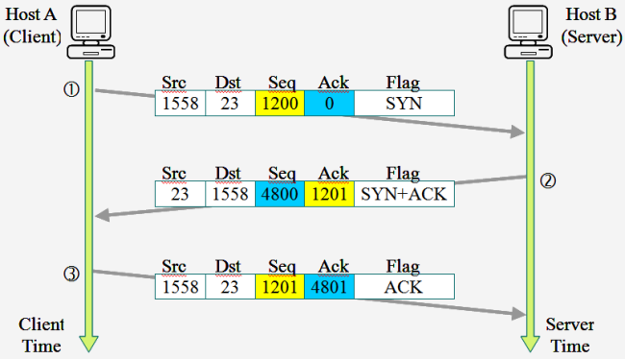
HOW DOES TCP WORK? (3 WAY HANDSHAKE)

Slide 44
SO, WHAT CAN GO WRONG?
Distributed denial of service
Port scanning
Interception
Replay
Spoofing/Masquerading
Hijacking

Slide 45
HOW TO WE IMPROVE THIS?
Remove non-essential services
See netstat
Keep systems updated
Use a firewall
Packet filtering, Stateful packet inspection, Deep packet inspection
Use a Proxy
Use a DMZ
Install Intrusion Detection System
Use VPN

Slide 46
FIREWALLS
A firewall is a device that filters network traffic (packets):
Look at IP address of source and destination. Are they allowed talk?
Look at TCP/UDP ports addresses. Are they allowed talk?
Examples of Packet Filtering:
FROM any TO any ALLOW tcp PORT 22
allows SSH to any internal machine
FROM any TO 192.168.1.30 ALLOW tcp (PORT 80 and PORT 443)
allow web traffic to machine 192.168.1.30
FROM any TO 192.168.35.* ALLOW tcp PORT 22

Slide 47
SOME DEFAULT RULES
FROM any TO any BLOCK TCP PORT all
FROM any TO any BLOCK UDP PORT all
FROM any TO all BLOCK ICMP (TYPE 0 AND TYPE 1 AND ... TYPE 255)
FROM any TO any ALLOW TCP PORT all
FROM any TO any ALLOW UDP PORT all
FROM any TO any ALLOW ICMP TYPE 8 CODE 0
Firewall rules are processed “in order”. The first that applies is used.
Basic rules treat each packet individually.

Slide 48
STATEFUL PACKET INSPECTION
Keep track of connections.
Only allows traffic that is part of an established connection, or an authorized new connection.
Can track when a connection closes.
This prevents attacks that try to disrupt servers.
For example, if a server receives a packet it thinks is out of order for a new connection – it may allocate space for the connection and wait.

Slide 49
DEEP PACKET INSPECTION
In deep packet inspection, the firewall looks at the contents of the message.
This is used in “intrusion detection systems” looking for common attacks.
I have seen it used to look for sending copies of the system password file
I have seen it used to look for other sensitive data being sent

Slide 50
PROXY FIREWALLS/SERVERS
Users log not or connect to the proxy server and ask it to access the internet for them.
Common for email servers – will prevent spam from getting to the actual server.
Common for web browsers –
Can prevent sending of specific browser information/machine information to server.
Can scan for and prevent certain types of web server attacks.

Slide 51




DMZ
A “demilitarized zone” (DMZ) is an extra layer of protection.
Internet
Internal Firewall
Internet- Facing Firewall
Web Server
Internal Network
DMZ

Slide 52
INTRUSION DETECTION SYSTEMS
An intrusion detection system (IDS) monitors your network to see if there is a problem.
Signature-based: These work by looking for known patterns of network traffic.
The rules require some expertise – but there is a community out there that keeps them up-to-date.
(See snort rule infographic)

Slide 53
INTRUSION DETECTION SYSTEMS (2)
Anomaly-based IDS
Instead of looking for known patterns, these look for unexpected behavior.
Alice always works 8-5. System sees Alice logging in at 1 am
Bob routinely visits the internet and downloads files. System sees Bob sending very large files.
These require some training or learning, and do not handle change well. Works very well for industrial control systems (except):
Imagine there is a new disaster, operator is now trying to shut down system that they normally never access.

Slide 54

WHERE DO YOU PUT IDS?
An IDS must be placed where it can view all of the network traffic that is of interest, but does not interfere with normal operations.
Internet
Internal Firewall
Internet- Facing Firewall
Web Server
Internal Network
DMZ

Slide 55
PROTECTING NETWORK TRAFFIC
You want to protect the authorized traffic that flows through your firewalls.
How? Encryption!!
Can permit only SSH, or HTTPS style connections.
There is IP-level security (IPSEC, IPv6), not commonly used.
These do prevent deep packet inspection.

Slide 56
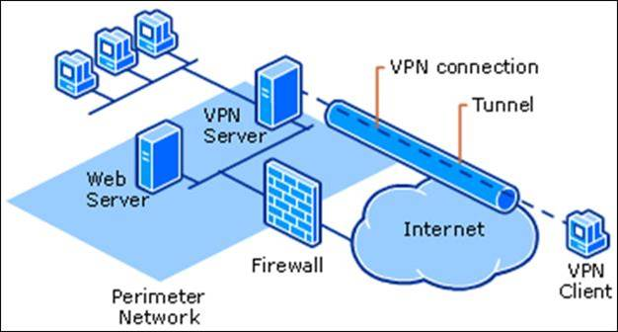
VIRTUAL PRIVATE NETWORK (VPN)
A VPN encrypts data between the client and a VPN server. The server then forwards on the information to local machines, using a local IP address. (using a technology called NAT).

Slide 57
NETWORK ADDRESS TRANSLATION (NAT)
NAT is used to translate an internal IP address to an external address.
Hides internal address
Allows use of private IP address space.
Ex: Dr. Alves-Foss research lab has 10 different computers connected to a single NAT router. All share one external IP address.
Ex: Dr. Alves-Foss home has 5 people, with 6 computers, 4 laptops, two tablets, 5 cell phones, 2 smart TVs, Video game console, 3 printers.
All connected through a local network (WiFi and ethernet cables).
All can connect to internet through routers, using 1 public IP address.

Slide 58
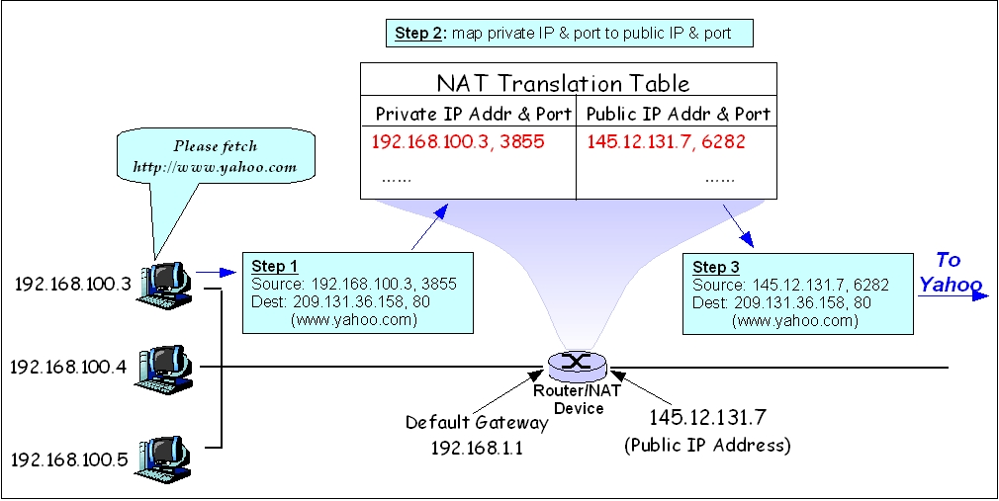
NETWORK ADDRESS TRANSLATION (NAT) (2)
By Yangliy at English Wikibooks - Transferred from en.wikibooks to Commons., Public Domain, https://commons.wikimedia.org/w/index.php?curid=61795882

Slide 59
PROTECTING WIFI
You can not use physical protections, your WiFi signals can go a long distance.
Most WiFi access points require passwords and encryption.
WEP (Wired equivalency protocol – too weak)
WPA (WiFi Protected access)

Slide 60
WIFI SECURITY
Strongest to weakest
WPA3
WPA2 Enterprise
WPA2 Personal
WPA + AES
WPA + TKIP
WEP
Open Network (no security implemented)

Slide 61
NETWORK SECURITY TOOLS
There are many of security tools these.
Can download and install Kali Linux VM https://www.kali.org which has many of these.
Recommended a minimum of 4GB Ram and 20GB Hard drive.
I recommend using Virtual Box and installing there:
https://www.virtualbox.org/wiki/Downloads
https://www.kali.org/docs/virtualization/install-virtualbox-guest-vm/

Slide 62
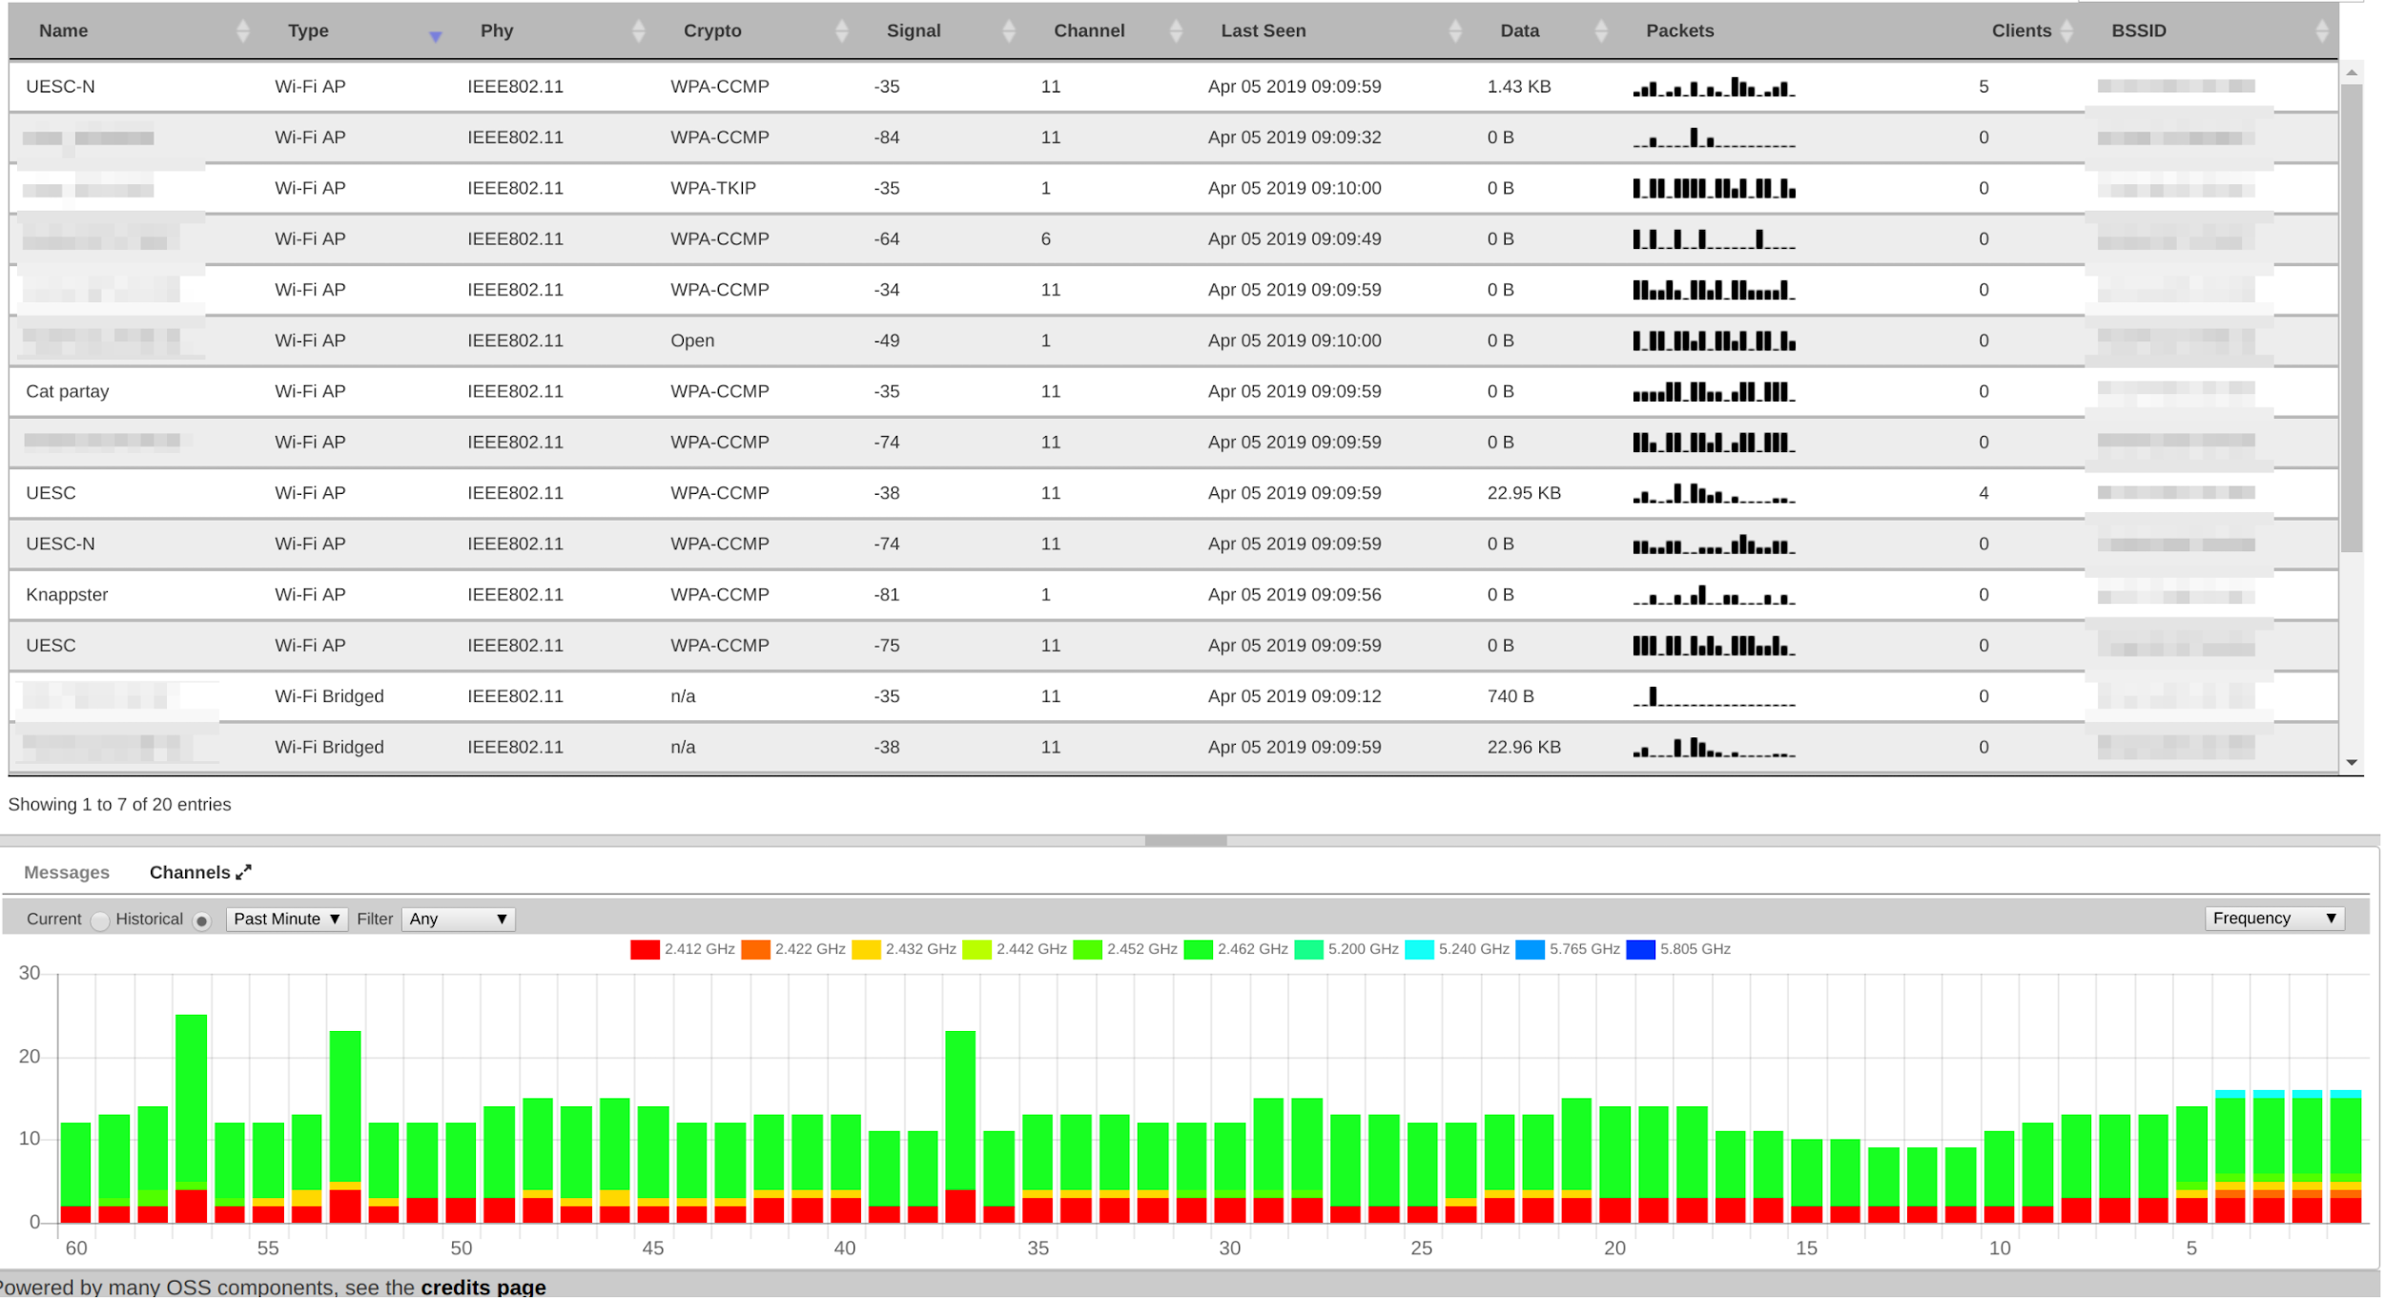
WIRELESS PROTECTION TOOLS
Can monitor for WiFi devices using a tool called Kismet.

Slide 63
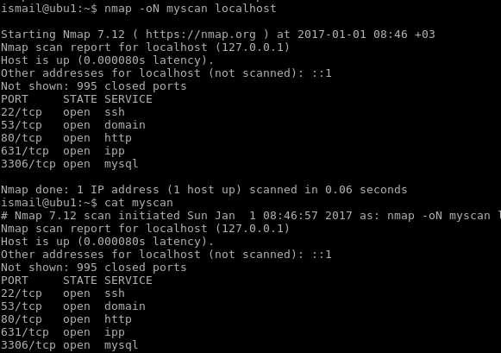
SCANNERS
These are used to see what devices are on your network.
Nmap is one example that scans for machines and open ports.
Be careful with this – not all networks allow it.

Slide 64
PACKET SNIFFERS
When you really understand networks and network protocols, you can use a packet sniffer.
This can show details of all traffic.
Some IDS will record the network traffic of interest (in a packet capture file – pcap) for analysts to look at later.
A popular GUI tool is Wireshark.
A popular command line tool is tcpdump.
You can write your own analyzers with libpcap software library

Slide 65
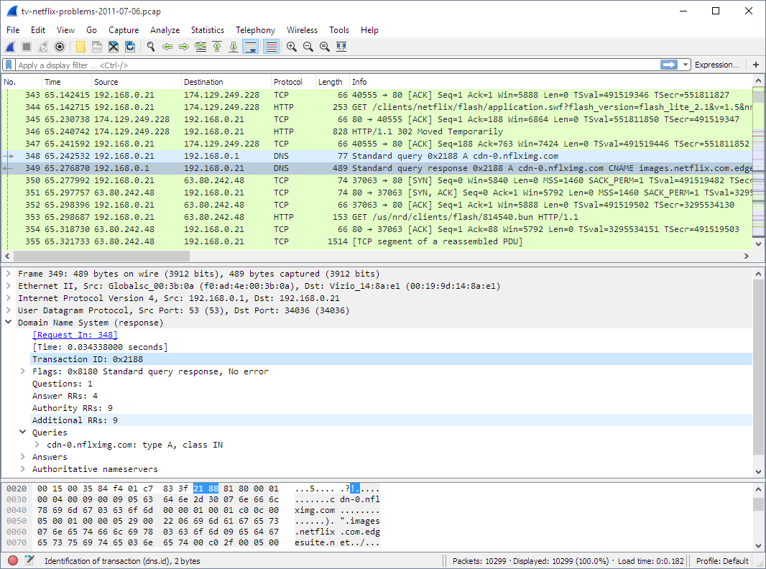

Slide 66
FIREWALL TOOLS
There are tools to map the topology of firewalls
One example is Scapy (https://github.com/secdev/scapy)
This uses ICMP (Internet Control Message Protocol) to examine the network – can evade seme normal security measures.
Can be uses as a standalone tool or scripted (programmes).

Slide 67
HONEYPOTS AND HONEYNETS
These are advanced tools. You set up “fake” computers and/or networks that have no real users or data.
Security tools then watch for and scan all traffic to these devices and networks – because that should be from the attackers.
Allows security analysts to see what attackers are doing.
Makes attackers waste their time looking for the “good” stuff.

Slide 68
PLEASE ATTRIBUTE DR. JIM ALVES-FOSS AND DR. JIA SONG, UNIVERSITY OF IDAHO EXCEPT WHERE OTHERWISE NOTED, THIS WORK IS LICENSED UNDER HTTPS://CREATIVECOMMONS.ORG/LICENSES/BY-NC-SA/4.0/ NOT WITHSTANDING THE NON-COMMERCIAL LICENSE TERMS, NON-PROFIT EDUCATIONAL INSTITUTIONS ARE GRANTED A NON-EXCLUSIVE LICENSE TO ADAPT AND USE THIS MATERIAL, WITH ATTRIBUTION. CREATIVE COMMONS AND THE DOUBLE C IN A CIRCLE ARE REGISTERED TRADEMARKS OF CREATIVE COMMONS IN THE UNITED STATES AND OTHER COUNTRIES. THIRD PARTY MARKS AND BRANDS ARE THE PROPERTY OF THEIR RESPECTIVE HOLDERS.

